Slide 1
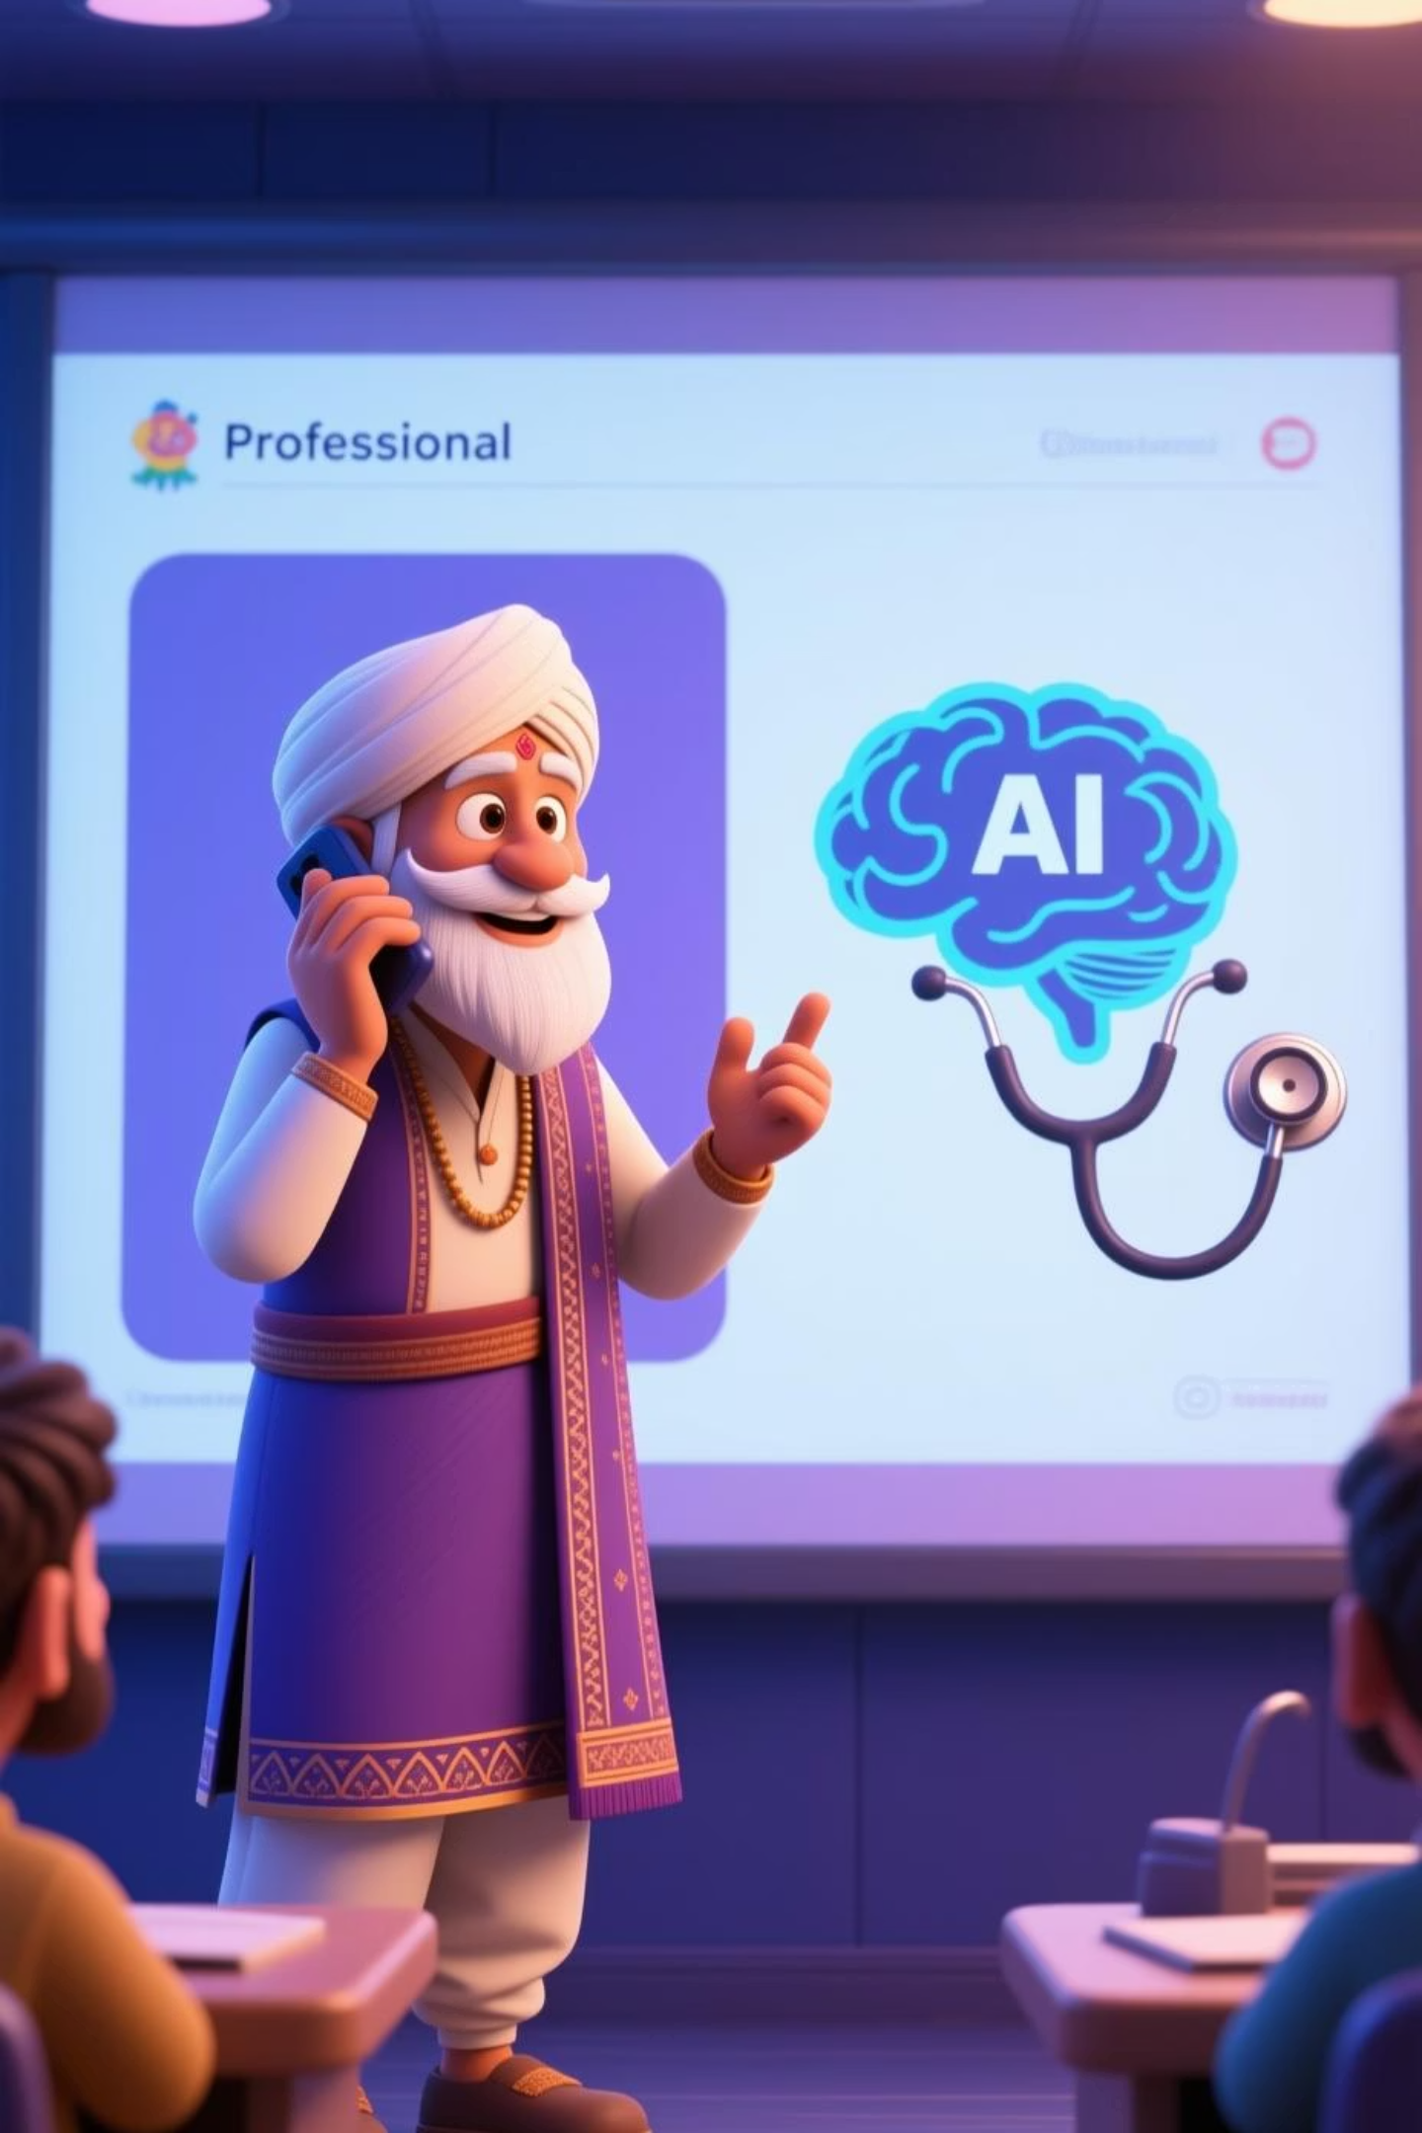
PulseVaani – Your AI Health Companion
"Empathy meets Intelligence in Indian Healthcare"
A Bilingual (Hindi + English) Voice + Health Prediction Platform
AI
Health
Voice
India

Slide 2

Addressing the Gap in Indian Healthcare
PulseVaani bridges the digital divide by offering accessible, multilingual support, moving “From complex data to compassionate dialogue.”
The Challenge
The Insight
Limited access to modern, tech-friendly healthcare tools for non-English and elderly users, especially in rural and semi-urban settings.
Elders and rural populations need intuitive, voice-based, bilingual interfaces for simple, reliable health support and monitoring.
The Solution: PulseVaani
An AI-powered web application providing essential health prediction and guidance through empathetic, bilingual (Hindi-English) voice assistance.

Slide 3

PulseVaani: Core Technology Stack
Our system combines advanced predictive AI with an accessible voice interface to deliver actionable health insights.
Predictive AI Engine
Bilingual Voice Assistant: "Dock"
Robust Tech Stack
Utilizes IsolationForest and Logistic Regression for rapid, early risk detection of common lifestyle diseases.
Built on React/Tailwind (Frontend) and Flask/Node.js (Backend), leveraging Firebase/MongoDB for scalable data management.
An empathetic virtual guide supporting seamless, natural conversations in both Hindi and English (via Web Speech API/gTTS).

Slide 4
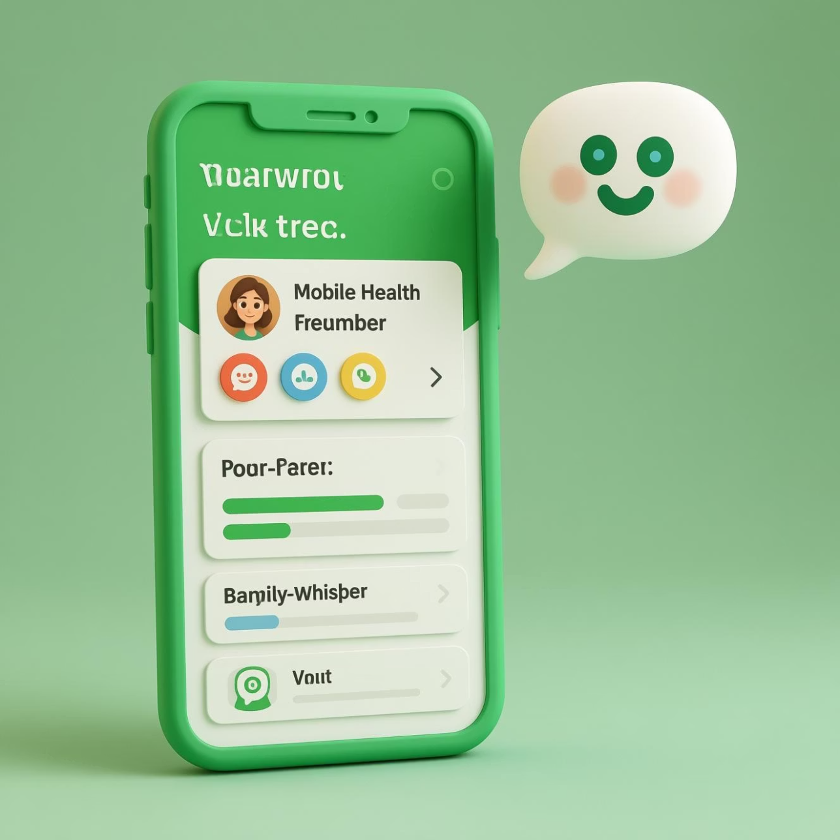
Designed for the Indian User: Intuitive Experience
Optimized for Accessibility
Clean, calming green–white hospital theme interface.
Simple icons, large buttons, and clear voice prompts tailored for elderly users.
Essential features: Quick Hindi/English language toggle.
User-friendly design with optional dark/light mode for visual comfort.
Interactive charts and health cards provide a straightforward overview of well-being.

Slide 5




Feasibility and Scalability: Reaching Every Corner of India
PulseVaani is engineered for widespread deployment, ensuring functional and reliable service even in challenging connectivity environments.
1
Low-Device Ready
IoT Integration
2
Easy connection with basic vitals monitoring devices (BP, Oximeter, Glucose).
Cloud Scalability
3
Backend deployed on the cloud to handle high traffic and data volume efficiently across regions.
Strategic Partnerships
4
Viable collaboration opportunities with local clinics and digital telemedicine providers.

Slide 6

Profound Impact and Core Benefits
PulseVaani delivers value across the healthcare ecosystem—from the patient to the clinician.
Social Equity
Reduces healthcare inequality by providing equal access to advanced, bilingual health monitoring tools.
Medical Precision
Enables early risk detection for non-communicable diseases like heart conditions, hypertension, and diabetes.
Economic Efficiency
Reduces costs for families and the system by preventing unnecessary, late-stage hospital visits.
Clinician Support
Provides doctors with real-time patient alerts and summarized health dashboards for proactive care planning.

Slide 7

Sustainable Business Model and Growth Strategy
A multi-pronged approach ensures financial viability and sustained investment in research and development.
Freemium
Subscriptions
Licensing & Analytics
B2B Partnerships
1
2
3
Freemium Core
Strategic B2B
Long-Term Licensing
Basic vitals tracking and core voice assistance remain free; advanced AI reports are offered via subscription.
Partnerships with healthcare providers, telehealth firms, and insurance companies for integrated offerings.
Licensing our predictive analytics engine and anonymized population health data (with consent) to large organizations.

Slide 8

Research Foundation and Team
PulseVaani is grounded in scientific rigor and driven by a diverse, specialized team.
Informed Development
Built upon studies in AI-assisted healthcare prediction, voice UX, and elder-centric digital design.
Key References
Referenced frameworks and data from WHO guidelines, NITI Aayog's AI in Health initiatives, and local IIT research papers.
Team Slug’sEra brings expertise in AI modeling, full-stack development, user experience design, and voice integration.

Slide 9
Next Steps: Join the Future of Health Tech in India
We invite you to partner with us to scale PulseVaani's deployment and predictive capabilities across India.
Feature Development
Funding for Scale
Introduce personalized health coaching and advanced risk stratification dashboards for clinicians.
Pilot Program Expansion
Secure seed funding to enhance AI model sophistication and expand language support (e.g., Marathi, Bengali).
Integrate PulseVaani into existing clinic and telemedicine networks in target regions.

Slide 10

A Compassionate Companion for Health
"PulseVaani isn’t just a tracker — it’s a caring, bilingual AI companion."
Connect with Us
Email: help@pulsevaani.in
Website: www.pulsevaani.in
Phone: +91 7701815002
Scan to experience the demo and voice interface.

